Slide 1
Pre-Requisite based Course Material for DBMS
Notes:
1
1

Slide 2
Introduction to Sets
Definition. A Set is any well defined collection of “objects.”
Definition. The elements of a set are the objects in a set.
Notation. Usually we denote sets with upper-case letters, elements with lower-case letters. The following notation is used to show set membership
means that x is a member of the set A
means that x is not a member of the set A.

Slide 3
Ways of Describing Sets
List the elements
Give a verbal description
“A is the set of all integers from 1 to 6, inclusive”
Give a mathematical inclusion rule

Slide 4
Some Special Sets
The Null Set or Empty Set. This is a set with no elements, often symbolized by
The Universal Set. This is the set of all elements currently under consideration, and is often symbolized by

Slide 5
Basic notations for sets
For sets, we’ll use variables S, T, U, …
We can denote a set S in writing by listing all of its elements in curly braces:
{a, b, c} is the set of whatever 3 objects are denoted by a, b, c.
Set builder notation: For any proposition P(x) over any universe of discourse, {x|P(x)} is the set of all x such that P(x).
e.g., {x | x is an integer where x>0 and x<5 }

Slide 6
Basic properties of sets
Sets are inherently unordered:
No matter what objects a, b, and c denote, {a, b, c} = {a, c, b} = {b, a, c} = {b, c, a} = {c, a, b} = {c, b, a}.
All elements are distinct (unequal); multiple listings make no difference!
{a, b, c} = {a, a, b, a, b, c, c, c, c}.
This set contains at most 3 elements!

Slide 7
Definition of Set Equality
Two sets are declared to be equal if and only if they contain exactly the same elements.
In particular, it does not matter how the set is defined or denoted.
For example: The set {1, 2, 3, 4} = {x | x is an integer where x>0 and x<5 } = {x | x is a positive integer whose square is >0 and <25}

Slide 8
Infinite Sets
Conceptually, sets may be infinite (i.e., not finite, without end, unending).
Symbols for some special infinite sets: N = {0, 1, 2, …} The natural numbers. Z = {…, -2, -1, 0, 1, 2, …} The integers. R = The “real” numbers, such as 374.1828471929498181917281943125…
Infinite sets come in different sizes!

Slide 9
The Empty Set
∅ (“null”, “the empty set”) is the unique set that contains no elements whatsoever.
∅ = {} = {x|False}
No matter the domain of discourse, we have the axiom
¬∃x: x∈∅.

Slide 10
Subset and Superset Relations
S⊆T (“S is a subset of T”) means that every element of S is also an element of T.
S⊆T ⇔ ∀x (x∈S → x∈T)
∅⊆S, S⊆S.
S⊇T (“S is a superset of T”) means T⊆S.
Note S=T ⇔ S⊆T∧ S⊇T.
means ¬(S⊆T), i.e. ∃x(x∈S ∧ x∉T)

Slide 11
The Power Set Operation
The power set P(S) of a set S is the set of all subsets of S. P(S) = {x | x⊆S}.
E.g. P({a,b}) = {∅, {a}, {b}, {a,b}}.
Sometimes P(S) is written 2^{S}. Note that for finite S, |P(S)| = 2^{|S|}.
It turns out that |P(N)| > |N|. There are different sizes of infinite sets!

Slide 12
Ordered n-tuples
For n∈N, an ordered n-tuple or a sequence of length n is written (a₁, a₂, …, a_{n}). The first element is a₁, etc.
These are like sets, except that duplicates matter, and the order makes a difference.
Note (1, 2) ≠ (2, 1) ≠ (2, 1, 1).
Empty sequence, singlets, pairs, triples, quadruples, quintuples, …, n-tuples.

Slide 13
Cartesian Products of Sets
For sets A, B, their Cartesian product A×B :≡ {(a, b) | a∈A ∧ b∈B }.
E.g. {a,b}×{1,2} = {(a,1),(a,2),(b,1),(b,2)}
Note that for finite A, B, |A×B|=|A||B|.
Note that the Cartesian product is not commutative: ¬∀AB: A×B =B×A.
Extends to A₁ × A₂ × … × A_{n}...

Slide 14
The Union Operator
For sets A, B, their union A∪B is the set containing all elements that are either in A, or (“∨”) in B (or, of course, in both).
Formally, ∀A,B: A∪B = {x | x∈A ∨ x∈B}.
Note that A∪B contains all the elements of A and it contains all the elements of B: ∀A, B: (A∪B ⊇ A) ∧ (A∪B ⊇ B)

Slide 15
Union Examples
{a,b,c}∪{2,3} = {a,b,c,2,3}
{2,3,5}∪{3,5,7} = {2,3,5,3,5,7} ={2,3,5,7}
2
5
3
7

Slide 16
The Intersection Operator
For sets A, B, their intersection A∩B is the set containing all elements that are simultaneously in A and (“∧”) in B.
Formally, ∀A,B: A∩B≡{x | x∈A ∧ x∈B}.
Note that A∩B is a subset of A and it is a subset of B: ∀A, B: (A∩B ⊆ A) ∧ (A∩B ⊆ B)

Slide 17
Intersection Examples
∅
{a,b,c}∩{2,3} = ___
{2,4,6}∩{3,4,5} = ______
{4}
3
2
4
6
5

Slide 18
Disjointedness
Help, I’ve been disjointed!
Two sets A, B are called disjoint (i.e., unjoined) iff their intersection is empty. (A∩B=∅)
Example: the set of even integers is disjoint with the set of odd integers.

Slide 19
Set Difference
For sets A, B, the difference of A and B, written A−B, is the set of all elements that are in A but not B.
A − B :≡ {x | x∈A ∧ x∉B} = {x | ¬( x∈A → x∈B ) }
Also called: The complement of B with respect to A.

Slide 20
Set Difference Examples
{1,2,3,4,5,6} − {2,3,5,7,9,11} = ___________
Z − N = {… , -1, 0, 1, 2, … } − {0, 1, … } = {x | x is an integer but not a nat. #} = {x | x is a negative integer} = {… , -3, -2, -1}
{1,4,6}

Slide 21
Set Complements
The universe of discourse can itself be considered a set, call it U.
The complement of A, written , is the complement of A w.r.t. U, i.e., it is U−A.
E.g., If U=N,

Slide 22
Set Identities
Identity: A∪∅=A A∩U=A
Domination: A∪U=U A∩∅=∅
Idempotent: A∪A = A = A∩A
Double complement:
Commutative: A∪B=B∪A A∩B=B∩A
Associative: A∪(B∪C)=(A∪B)∪C A∩(B∩C)=(A∩B)∩C

Slide 23
Introduction to Databases
Information is not useful if not organized
In database, data are organized in a way that people find meaningful and useful.
Database Management System (DBMS) is used to input, sort, organize and store data.

Slide 24
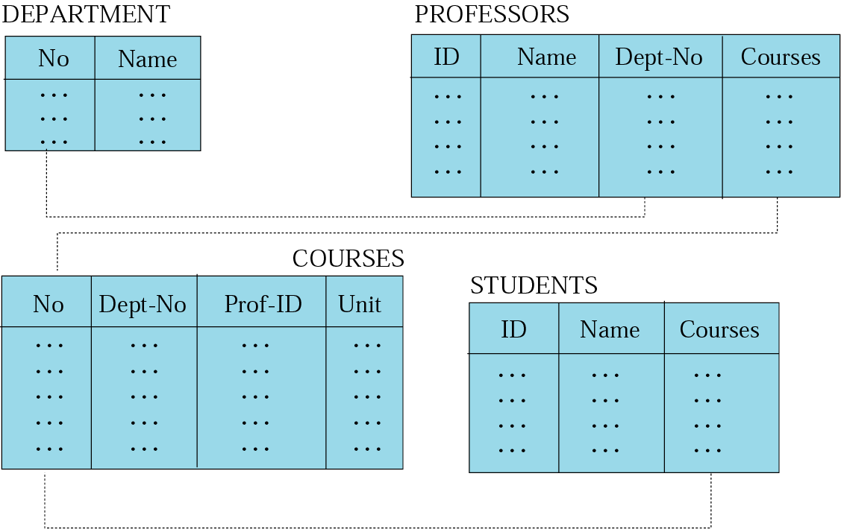
Relational model
Data are organized in two dimensional tables (relations)
Tables re related to each other
Relational Database Management System (RDBMS) are more common model used today

Slide 25
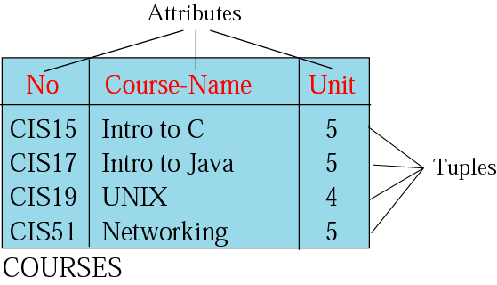
Relation (Name, Attributes, Tuples)
Attributes are the column heading
Each column must have a unique heading
Number of columns is called the degree of the relation
Tuple is a collection of attribute value
Total number of rows is called Cardinality of the relation
Each relation must have a unique name
Name
Relation appears in 2 dimensional table
That doesn’t mean data stored as table; the physical storage of data is independent of the logical organization of data

Slide 26
OPERATIONS
ON
RELATIONS

Slide 27
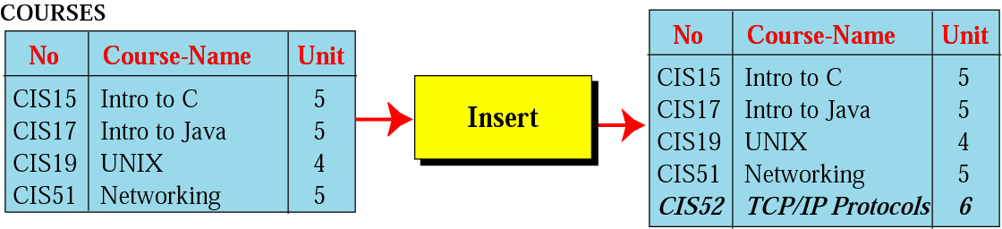
Insert operation
Unary operation
Insert Operation: Inserts new tuple into the relation

Slide 28
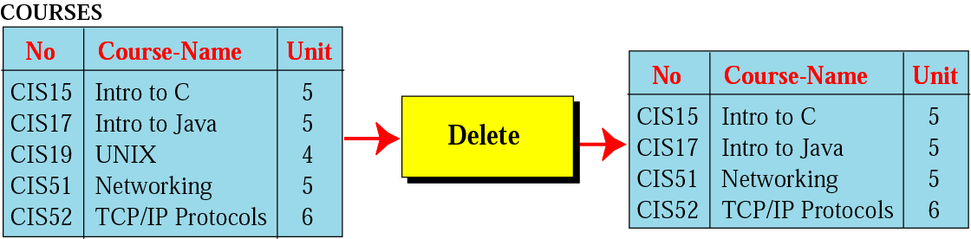
Delete operation
Unary operation
Delete Operation: Deletes tuple from the relation

Slide 29
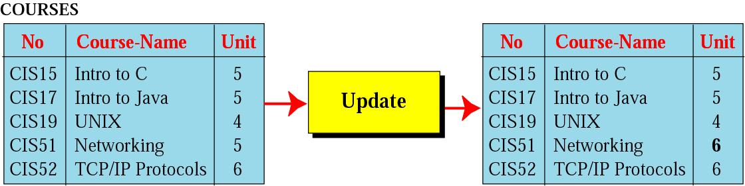
Update operation
Unary operation
Update Operation: Changes the values of some attributes of a tulpe

Slide 30
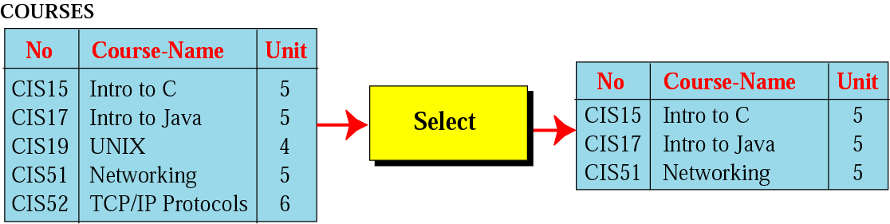
Select operation
Unary operation
Select Operation: Uses some criteria to select some tuples from the original relation

Slide 31
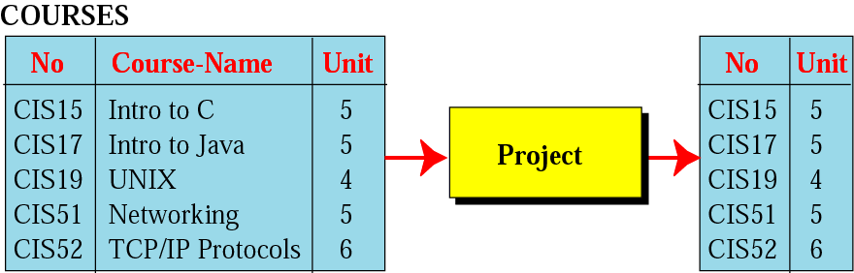
Project operation
Unary operation
Project Operation: Creates relation in which each tulpe has fewer attributes

Slide 32
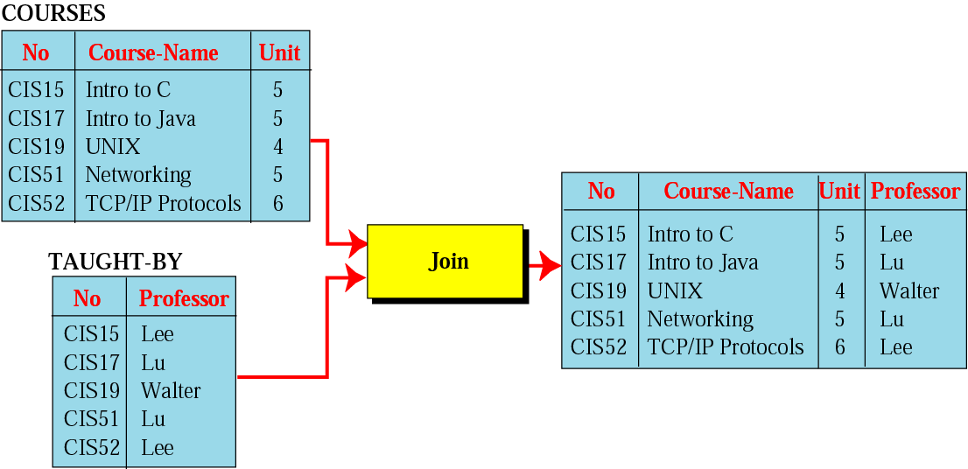
Join operation
Binary operation
Join Operation: Takes two relation and combine them based on common attribute

Slide 33
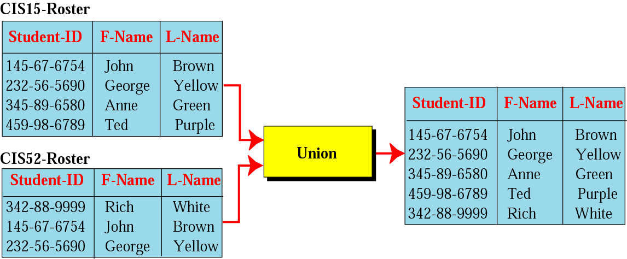
Union operation
Binary operation
Union Operation: Creates new relation in which each tuple is either in the first relation, the second relation or in both

Slide 34
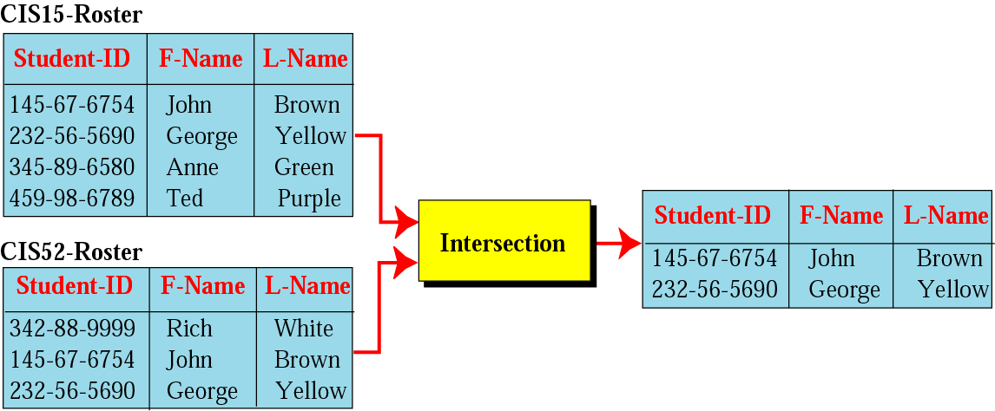
Intersection operation
Binary operation
Intersection Operation: Creates new relation in which each tuple is either in both relations.

Slide 35
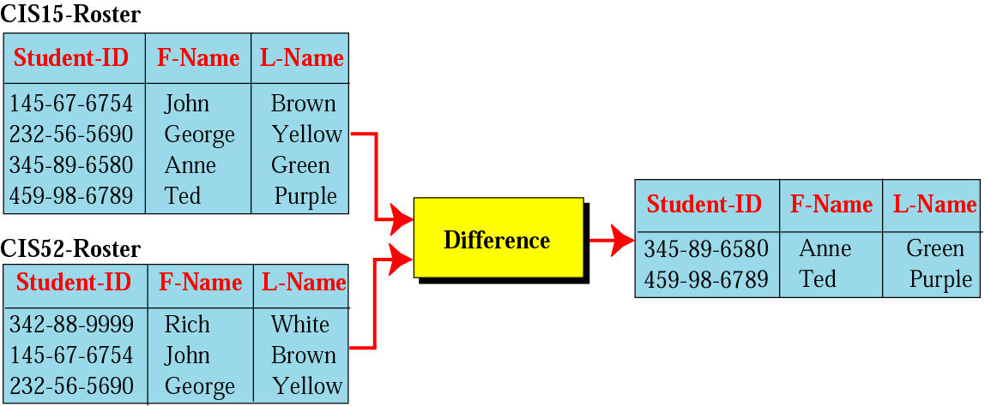
Difference operation
Binary Operation
Difference Operation: Creates new relation where the new tuples are in the first relation but not in the second.

Slide 36
THANK YOU

